Slide 1
Museum of Discovery and Science App Proposal
Group 2: Rebecca Russell, Tiago Baptiste, Daniel Feldan

Slide 2
Purpose
Give parents a tool to use to learn which exhibits their child would enjoy the most.
Give The Museum of Discovery and Science a survey of the children who attend the museum that would show the museum which exhibits that are the most popular for specific age groups.

Slide 3
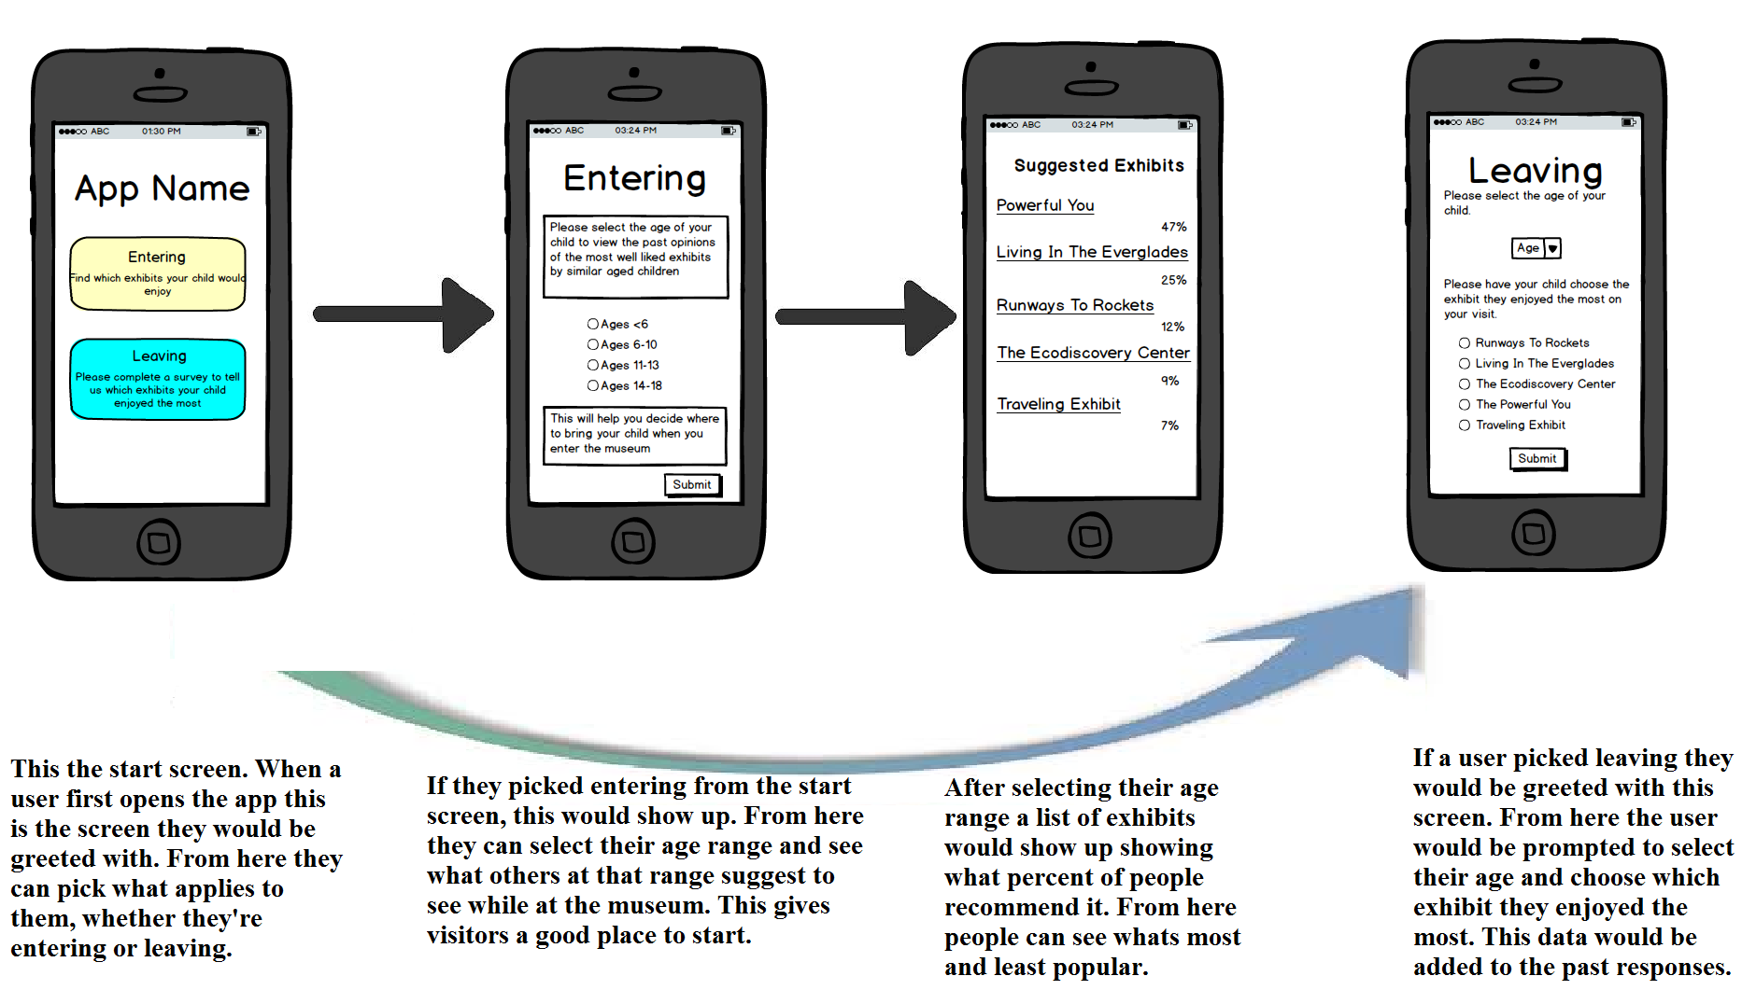
Storyboard

Slide 4
Informational Aspect
Parents can use the information they gain from the “Entering” screen to guide their way through the museum and get the best experience possible.
The Museum of Discovery and Science could use the results of the “Leaving” screen survey to further enhance the quality of the exhibits. They could start to enhance the exhibits to attract the attention of all age groups of children.

Slide 5
Educational Aspect
The app we are proposing will help the children attending the museum maintain constant interest in the information provided at the museum. This will occur through the use of the “Entering” screen. Since the parents of the child will know where their children will be happiest, the child will not become bored and want to end their trip early. By remaining interested, the children will focus more on the exhibits and get the most educational material out of their trip to the museum.

Slide 6
Overall Benefits
The museum will be able to entertain their guests more efficiently.
The children will get the best educational experience from all the Museum of Discovery and Science has to offer.

